Slide 1

Deep Learning vs. Traditional Machine Learning For a Binary Classification Problem
Mentor: Dr. Seongtae “Ty” Kim
Advisor: Dr. Sayed Mostafa
Capstone Project Professor: Dr. Liping Liu
By: Mehmet Arslan
May 5, 2022

Slide 2
Contents
Background Concepts & Intro to ANN
Research Question
Convolutional Neural Networks
Recurrent Neural Networks/LSTM
Discussion & Limitations
Conclusions
References

Slide 3
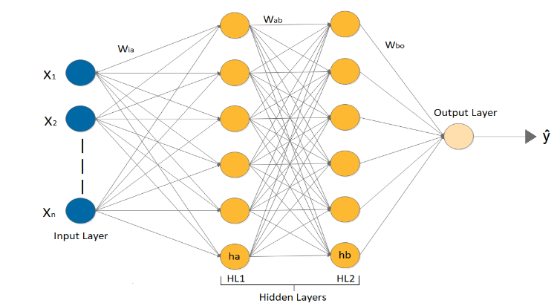
Simple Artificial Neural Network
(Thomas, Pradhan, Dhaka, 2020)
Notes:
We see that the neural net computes the weights and biases the entirety of the input layer. The input layer is basically the layer that contains our features/predictor variables. After the weights and biases have been computed, they are then passed to their individual activation functions, and then passed to the next layer.
There is a saying in Neurology: Neurons that fire together, wire together. In essence, this implies that we may fine-tune which nodes fire at which time. This is the key to creating superhuman performance in terms of data.
Every neural net works on the concept of forward-feeding and back propagation.

Slide 4
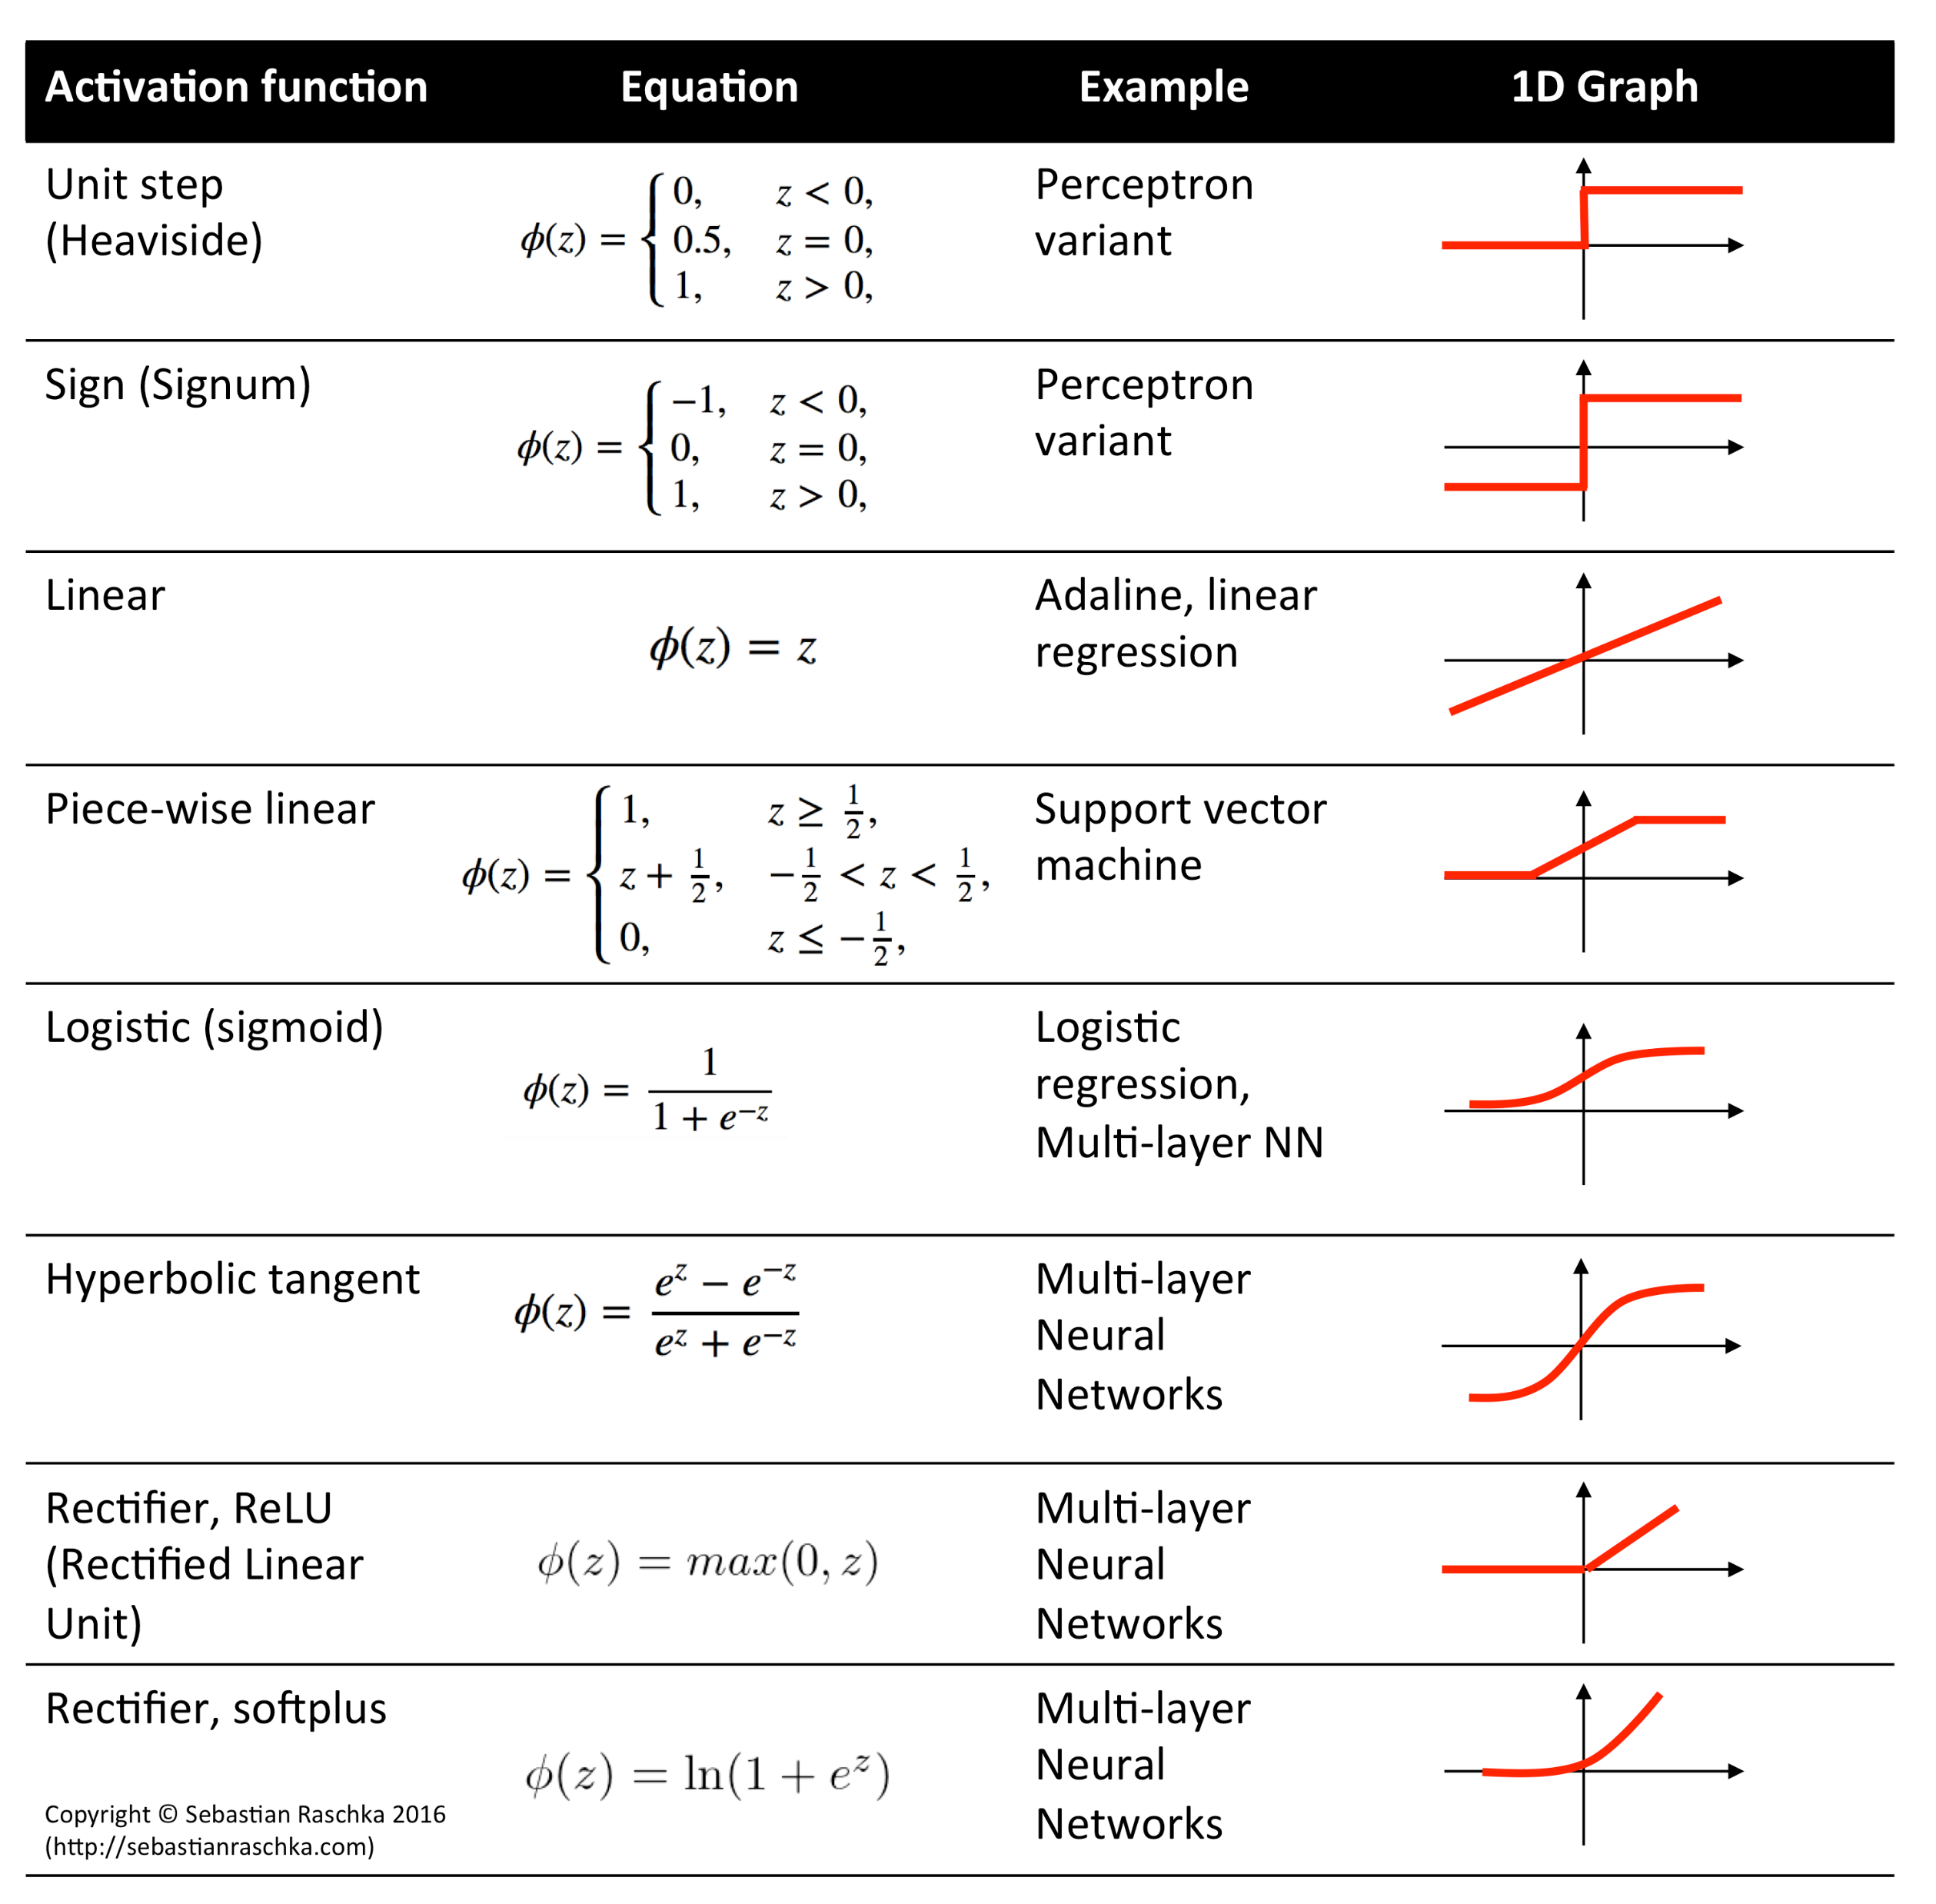
Different Types of Activation Functions in Deep Learning
(Raschka, 2014)
Notes:
Activation functions are used to illustrate the relationship between data(inputs) (previous hidden layer) and their outputs (next hidden layer)(predictions)
Each one can serve a unique purpose, for instance Sigmoid activation functions is often used for Binary Classification problems. It is important to note that this activation must be performed at the end of the model's architecture.

Slide 5
How Deep Learning Differs From Traditional Machine Learning
Deep Learning utilizes big data in a complex architecture, often several layers, with increasing complexity.
Deep Learning also employs much more sophisticated techniques such as data preprocessing(tensorization), dropouts, regularizations, etc.
Doing so yields higher accuracy in general because of these processes.
Note that a traditional ANN typically follows an architecture of two-three hidden layers used, but in Deep Learning we can use as many layers as we please, sometimes in the hundreds of layers!
Notes:
Note that when we build a Deep Learning model, we refer to its primary architecture.
This includes things such as: the type of neural net being used, how many layers there are within the neural net, fully connected (dense) layers, etc.

Slide 6
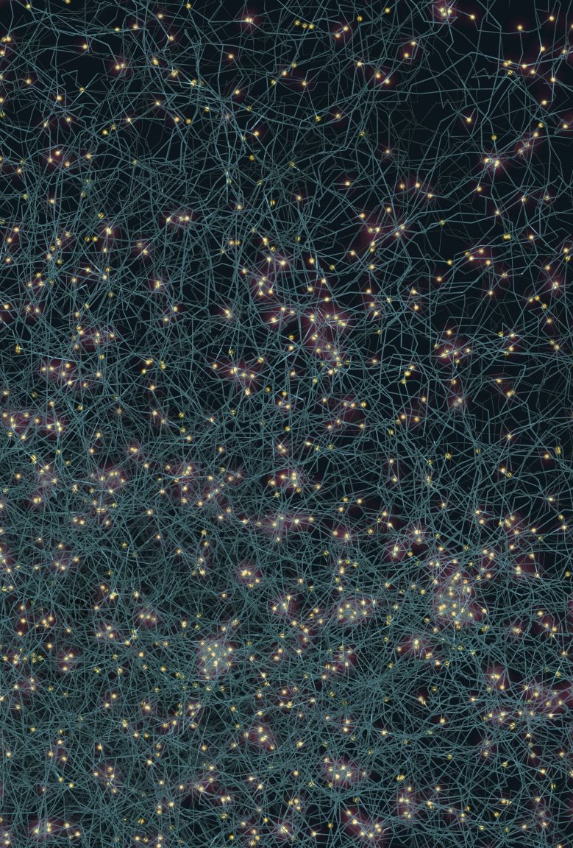
Background Knowledge
Previously, analyzing this type of data was always difficult, however, Deep Learning algorithms are perfectly suited for analysis tasks on non-conventional/unstructured data such as movie reviews.
Which Neural Networks are right and for what purpose?
Well, each type, be they ANN, CNN, RNN/LSTM, all have their unique use cases, and all provide different but equally meaningful results.
For my project, most of these Neural Networks work quite well with the Binary Classification problem.

Slide 7

Essential Research Questions
Can a Deep Learning Algorithm Make accurate predictions for the sentiment of a movie review?
If so, how well can they perform As compared to traditional Machine Learning?

Slide 8
Methodology
For the purposes of this project, I chose a traditional Machine Learning algorithm, K-Nearest Neighbors, and then a myriad of Deep Learning Algorithms: Simple Artificial Neural Networks, Convolutional Neural Networks, and Recurrent Neural Networks.
Their Performance was measured in terms of accuracy
The Dataset used in this project was the IMDB reviews dataset found in the Keras package in TensorFlow.
Notes:
The IMDB reviews dataset is a dataset that is 100,000 observations large and is broken up into 4 equally sized datasets: train data, train labels, test data, and test labels with each being 12,500 observations in size.
Validation datasets as well as partial training datasets were used: x train, x test, y train and y test.
The validation data was built for both x and y. They sampled 10,000 positive and 10,000 negative selected at random.

Slide 9
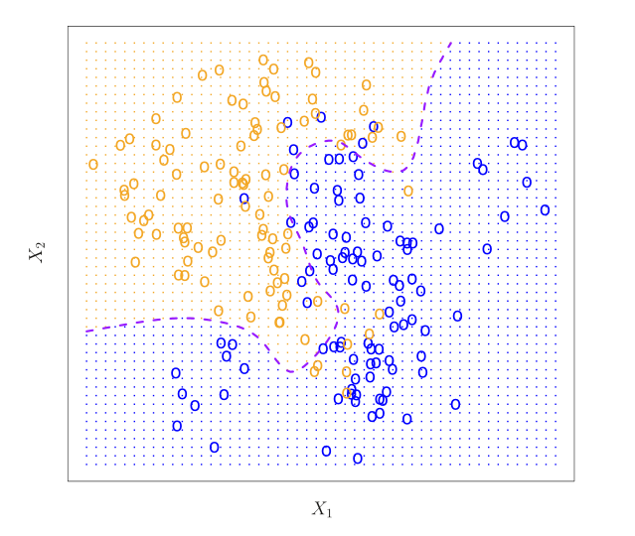
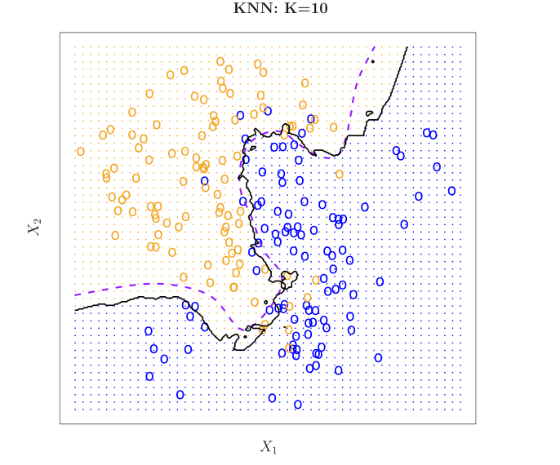
Implementation of K – Nearest Neighbors Algorithm
Simple Conceptualization of a K – Nearest Neighbor Classifier
The K – Nearest Classifier yielded an accuracy of ~ 50%
(James et al. 40, 41)
(James et al. 40, 41)

Slide 10
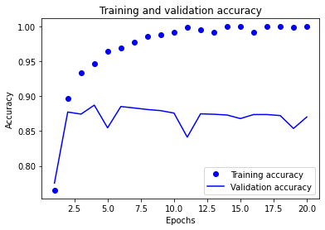
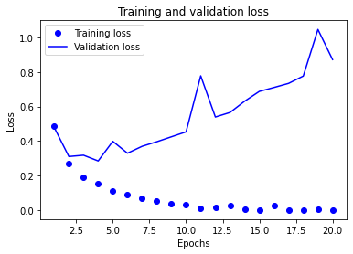
Implementation of a Vanilla Artificial Neural Network
The implementation of the Vanilla Artificial Neural Network proved some interesting results.
The overall results generated an accuracy of ~ 90% and a loss value of ~ 0.35
Notes:
Note that the plots of accuracy & loss respectively are clearly demonstrating a severe overfitting problem.
This can be resolved, but it is our job to get the model to overfit and then retrain the model such that we only have a robust fit, not an overfit.

Slide 11
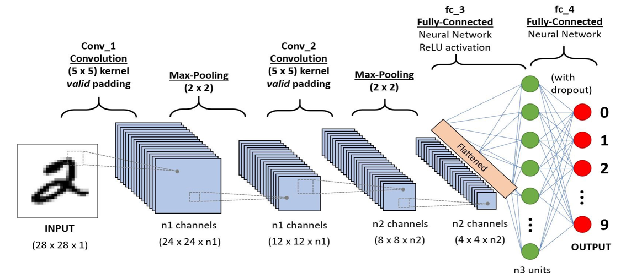
Convolutional Neural Network Architecture
(Rhatan, 2020)
Notes:
We perform convolutions on image data to then filter them into their base characteristics.
Think of a picture as a matrix that contains several matrices within it. Well, couldn’t we simply break up the larger “matrix” and determine which parts of the smaller matrices attribute the most to the larger matrix? Yes! The process of doing this is known as a convolution!

Slide 12
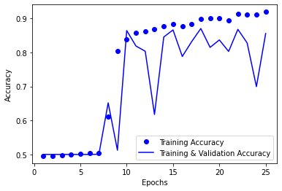
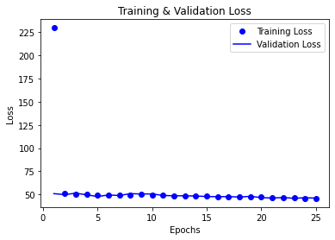
Implementation of a CNN for Text Classification
To utilize a CNN on the IMDB reviews dataset in the Keras package, I utilized some data preprocessing techniques such as: sequencing, one-hot encoding, embedding, and building a validation dataset.
The CNN with a 50% dropout layer yielded an accuracy of ~ 87% and a loss value of ~ 50.14

Slide 13
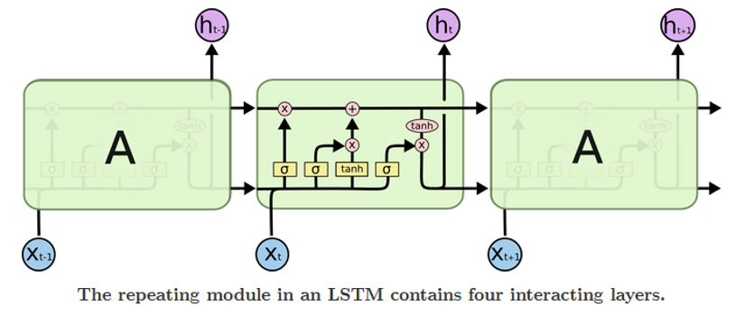
Long Short-Term Memory Architecture
Long short-term memory architecture models have a chain like structure, but the repeating module has a different structure. For instance, there are four neural network layers instead of just one, and each one is interacting with each other in a very special way.
(Olah, 2015)

Slide 14
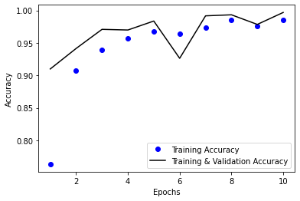
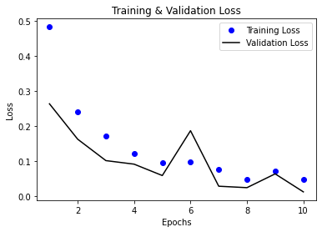
Implementation of an RNN/LSTM for Text Classification
Much like a CNN, an RNN is very similar in terms of how to implement them. That is, the steps are similar in that the preprocessing and one-hot encoding is the same. The use of a sequential model is also nearly identical.
Having implemented the RNN/LSTM, my model obtained an accuracy of ~ 92% and a loss value of ~ 0.07

Slide 15
Summary
Deep Learning algorithms can indeed make accurate predictions on the sentiment of movie reviews.
As the data shows, Deep Learning algorithms can outperform traditional machine learning algorithms.
Model Type | Accuracy
K-Nearest Neighbors | 50.2%
Vanilla ANN | 90.8%
CNN w/ Dropout | 87.1%
RNN/Bidirectional LSTM | 92.4%
Notes:
Another thing to note is that an increase in model complexity is also referred to as a flexible model.
This means that we can continually improve the model’s overall performance and reduce the overfitting problem using advanced and more sophisticated techniques.
Another thing to note: The K-Nearest Neighbors algorithm took nearly 40 minutes to converge. Whereas the Deep Learning algorithms took about half the time to perform.
This of course implies that the more complex models, taking advantage of parallel computing on a GPU, typically converge much faster.
Also note that the K-Nearest Neighbors, potentially as a result of poor model building, severely overfit (to training data if I recall correctly).

Slide 16
Discussion & Limitations
Sequenced data, such as movie reviews, are immensely difficult to work on without clever techniques.
Sequenced data requires quite a bit of preprocessing/tensorization to allow them to pass through the neural net.
For this reason, the inherent characteristics of the RNN architecture performs the best overall.
Limitations include the fact that we must be much more careful when applying dropouts to an RNN.
Notes:
RNN’s are built and tuned such that they automatically drop a little bit of the data going from one layer to the next. If we do implement dropouts to an RNN, we must be extremely cautious as we can risk causing worse overfitting issues rather than resolving them.

Slide 17
Conclusion
Main findings –
RNNs are suited for sequenced data in particular because of their flexibility, and the fact that RNNs are somewhat “aware” of context when it comes to text classification.
Traditional ML algorithms cannot perform well on large datasets. Recall that the IMDB reviews dataset was 100,000 observations large.
Future Study – Further implementation of more flexible algorithms on sequenced data, and conventional data.

Slide 18
References
Thomas, Tanishk & Pradhan, Nitesh & Dhaka, Vijaypal. (2020). Comparative Analysis to Predict Breast Cancer using Machine Learning Algorithms: A Survey. 192-196. 10.1109/ICICT48043.2020.9112464.
James, Gareth, et al. INTRODUCTION to STATISTICAL LEARNING : With Applications in R. 2nd ed., S.L., Springer-Verlag New York, 4 Aug. 2021, pp. 40, 41.
Olah, Christopher. “Understanding LSTM Networks -- Colah’s Blog.” Github.io, 2015, colah.github.io/posts/2015-08-Understanding-LSTMs/. Accessed 21 Apr. 2022.
Raschka, S. (2014). Activation Functions for Artificial Neural Networks - mlxtend. Rasbt.github.io. https://rasbt.github.io/mlxtend/user_guide/general_concepts/activation-functions/
Rhatan, Phani. “What Is the Convolutional Neural Network Architecture.” Analyticsvidhya.com, 8 Oct. 2020, www.analyticsvidhya.com/blog/2020/10/what-is-the-convolutional-neural-network-architecture/. Accessed 21 Apr. 2022.

